Slide 1

Analysis and Prediction of YouTube Trending Videos
by Ariel Li, Jiaying Du, Sylvie Pan, Xinyuan Gao

Slide 2






Agenda
Business Problem
Data Overview
Exploratory Data Analysis
Feature Engineering and Visualization
Modeling and Prediction
Future Work and Deployment

Slide 3

Business Overview

Slide 4
Business Case Summary
YouTube is the world’s most popular
video-sharing platform. Its popularity has prompted companies to put their ads on the website. Since the views accurately reflect the scope of audience an ad can reach, it is in the marketing companies’ interest to find out whether a video will go viral to decide where to cast their campaigns on this video.
To achieve this goal, we analyzed the YouTube trending videos in 3 English-
speaking countries, Canada, the UK and the US, conducted feature engineering and built a classification model to predict if a video will go viral.

Slide 5

Data Overview

Slide 6




Data Summary
Data Source:
Kaggle YouTube Trending Video Statistics
Datasets:
Canada (40881 records)
UK (38916 records)
US (40949 records)
Date Range:
November 2017
- June 2018
Number of Variables:
17

Slide 7
A Closer Look in Data
9 Features of Type Object:
String: Video ID, title, channel title, tags, thumbnail link, description, category
Datetime: trending date, publish time
5 Features of Type Integer:
Views, likes, dislikes, comment_count, category ID
3 Features of Type Boolean:
Comments_disabled, ratings_disabled, video_error_or_removed
Notes:
Type object
7 variables of type string. (title, tags, description, category) provide more useful text information
2 datetime variables
thumbnail link: the link to the image that’s used as the snapshot of the video

Slide 8

Exploratory
Data Analysis

Slide 9
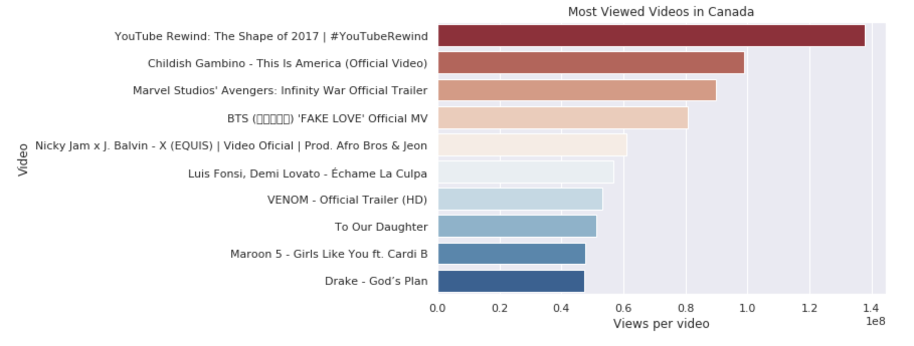
Most Viewed Videos in Canada
Notes:
Top 10 most viewed videos in Canada
Top video has more than 140 million views. Others are between 50 to 100 million views.
Mostly music videos and a couple of movie trailers. To our daughter by Kylie Jenner is the only vlog.

Slide 10
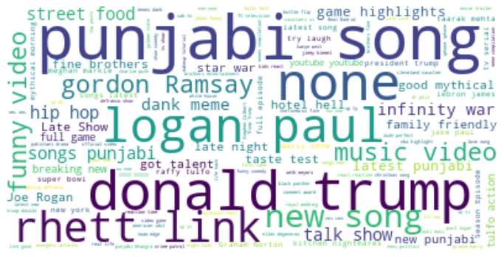
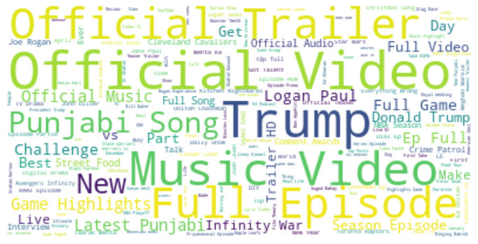
Word Clouds for Videos in Canada
Word cloud for tags
Word cloud for titles
Notes:
Tags - gives you an understanding of video content
rhett and link, logan paul - youtube comedians

Slide 11
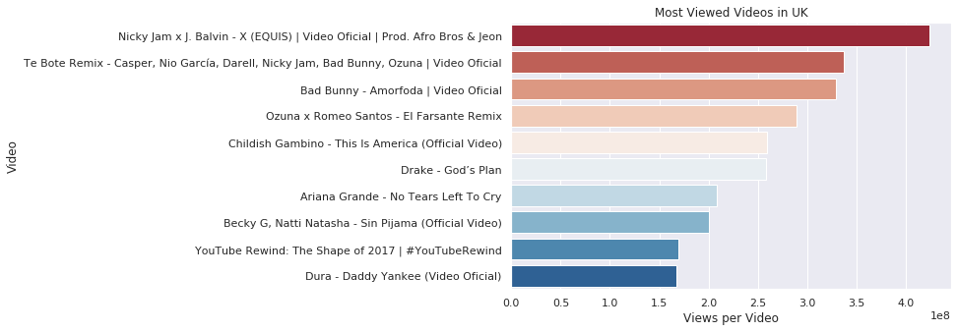
Most Viewed Videos in UK
Notes:
Top 10 most viewed videos in UK
Top video has more than 420 million views, which is 3 times that of Canada. And all the top 10 videos have more views compared to the top 10 in Canada.
Can see repetitions in the most viewed videos, meaning that the same videos can trend across different countries.
All are music videos, and 6 of them are spanish songs.

Slide 12
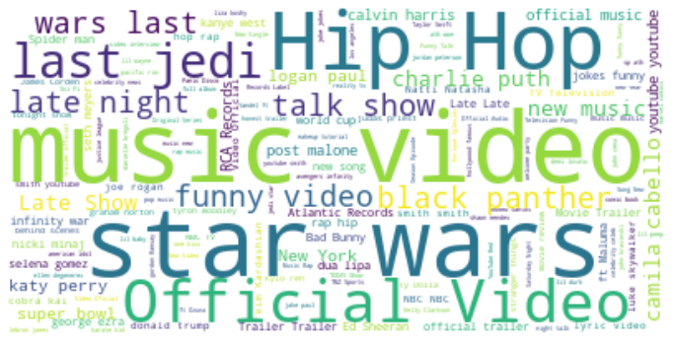
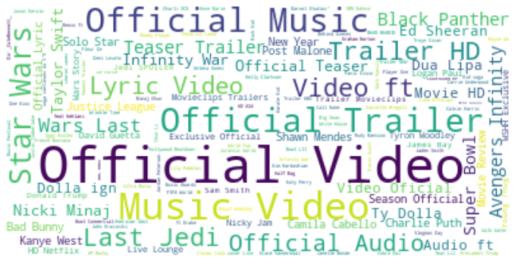
Word Clouds for Videos in UK
Word cloud for tags
Word cloud for titles

Slide 13
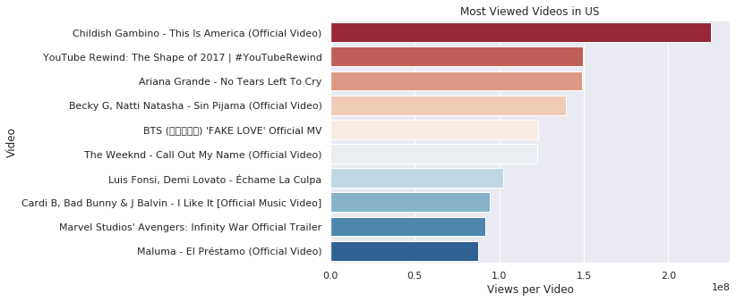
Most Viewed Videos in US
Notes:
Top 10 most viewed videos in US
Top video has around 230 million views. And the other top 10 videos have views in the 100 to 150 million range. less than UK but more than CA
Again, we see repetitions in the most viewed videos with both Canada and UK.
All are music videos except one (movie trailer).

Slide 14
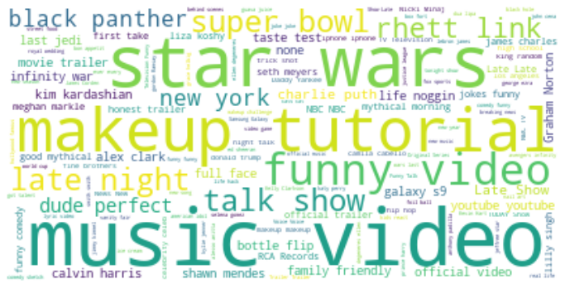
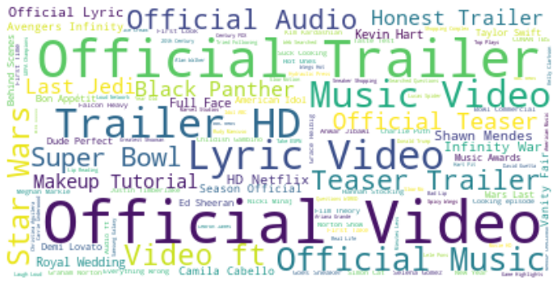
Word Clouds for Videos in US
Word cloud for tags
Word cloud for titles
Notes:
tags we didn’t see before - makeup tutorial
titles - aside then music videos and trailers which also trend in other countries, we see super bowl and makeup tutorial trending.

Slide 15
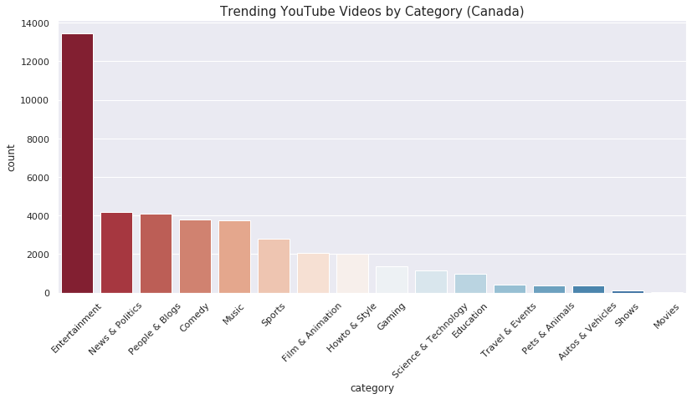
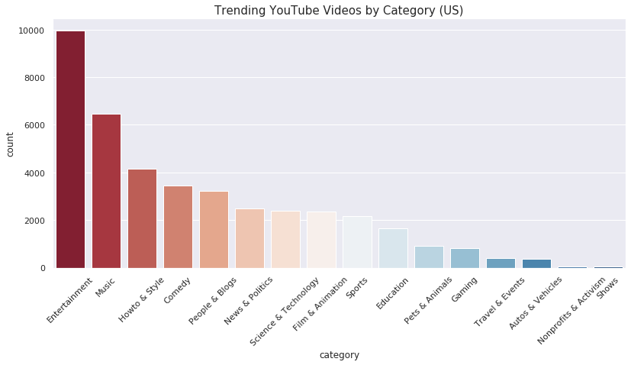
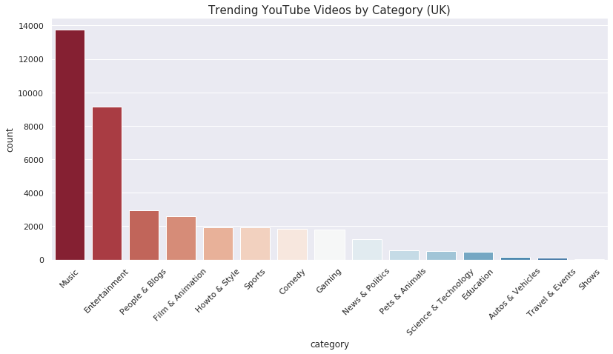
Categories of Trending Videos
Notes:
left hand side: US - top categories are entertainment, music, howto and style
top right: Canada - top categories are entertainment, news&politics, people & blogs
bottom right: UK - top categories are music, entertainment, people and blogs

Slide 16
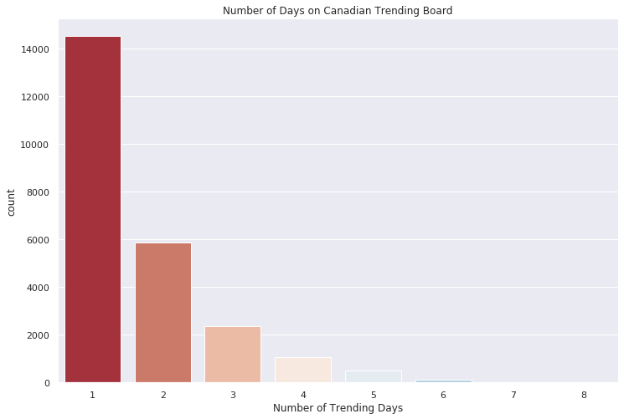
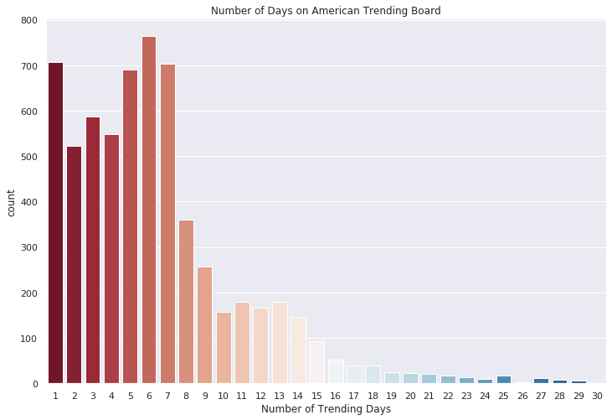
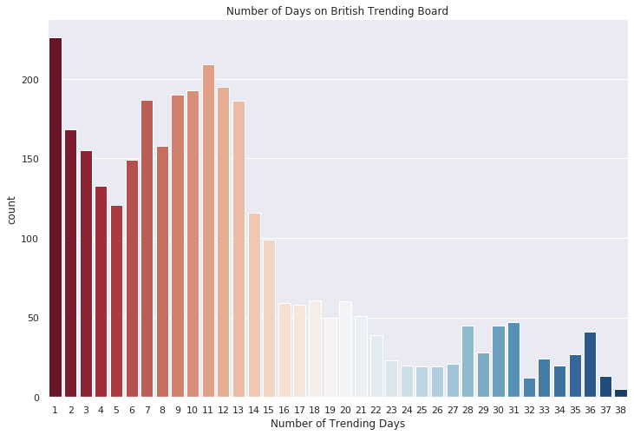
Number of Trending Days
Notes:
left hand side: US -
top right: Canada - shortest trending duration - within one week
bottom right: UK - longest trending duration

Slide 17
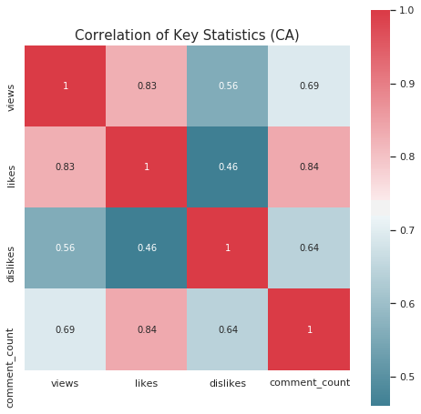
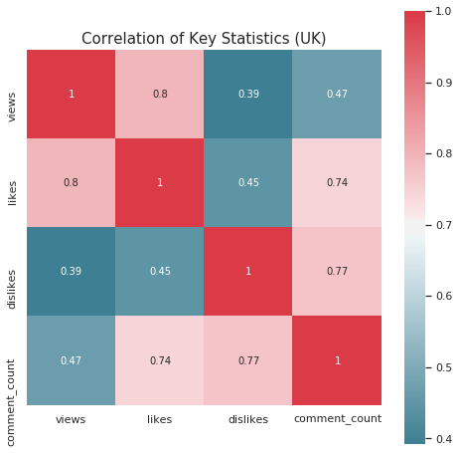
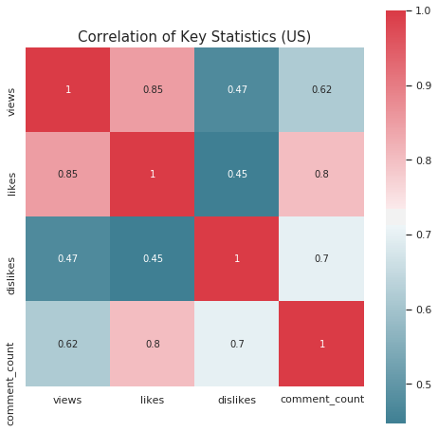
Correlation Heatmaps
Notes:
Change to correlation heatmap between 3 countries

Slide 18
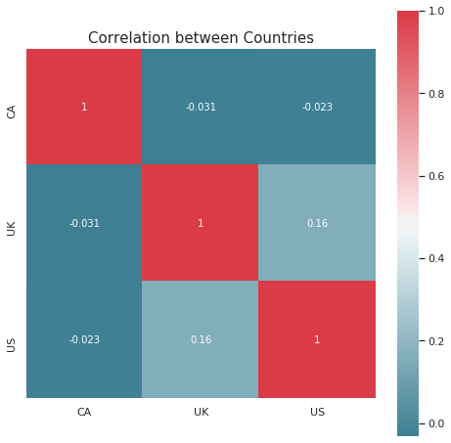
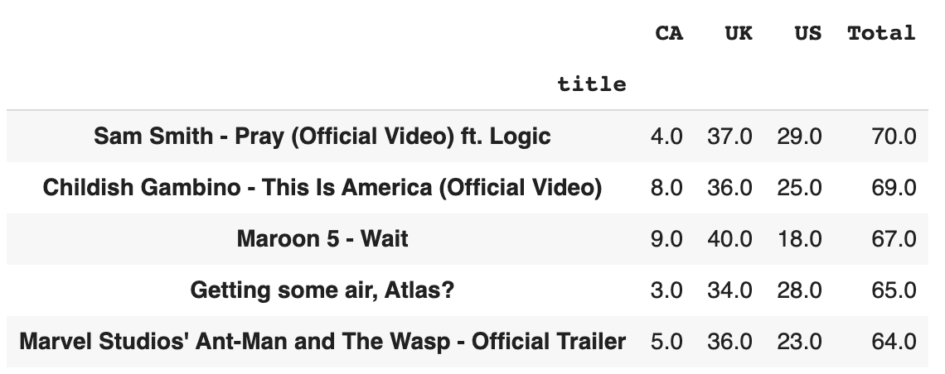
Trending Videos Across Countries
Top Videos with Longest Combined Trending Duration
Videos Trended in >1 Country:
89%
Notes:
Left: heatmap of correlation between countries
videos in UK and US have the highest correlation while videos in CA and UK have the least correlation
Right: top 5 videos with the longest combined trending duration - the highest total number of days on trending boards across 3 countries
89% of videos trended in more than 1 country, suggesting an more multilateral viewership

Slide 19

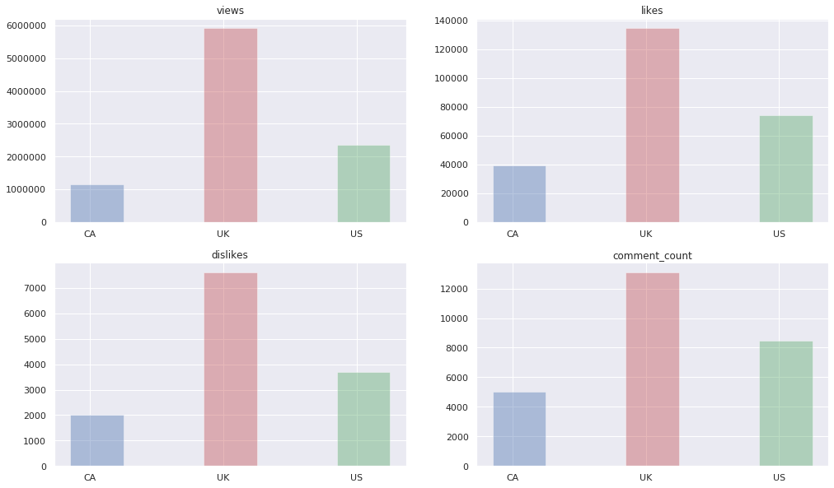
Statistics by Country
Average Views, Likes, Dislikes & Comment Counts
Notes:
UK has the highest average views, likes, dislikes and comment_count: highest viewership and most engagement
followed by US, then CA.

Slide 20

Feature Engineering and Visualizations

Slide 21
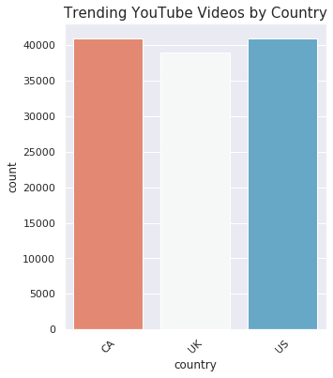

Merging Datasets
Target Variable: views_cat
(120746, 18)
(120746, 19)

Slide 22
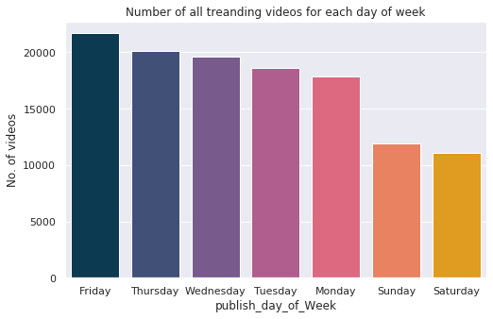

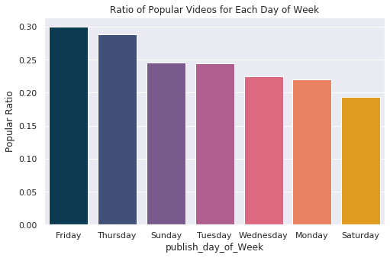
Publish Time: publish_day_of_Week
Create new feature called “publish_day_of_week” from “publish_time”.
Separate date, hour and time into three columns from 'publish_time' column.
Create feature to calculate the number of days between publish date and trending date.
Notes:
We can see that the number of trending videos published on Sunday and Saturday are noticeably less than the number of trending videos published on other days of the week.

Slide 23
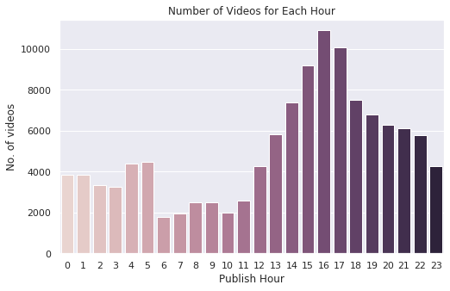
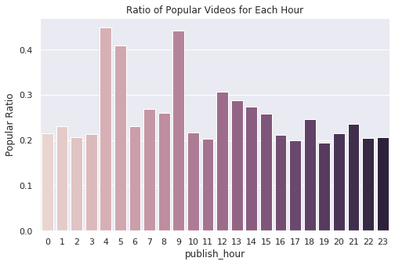
Publish Time: publish_hour
Notes:
We can see that the period between 2PM and 7PM, peaking between 4PM and 5PM, had the largest number of trending videos. We notice also that the period between 6AM and 7AM has the smallest number of trending videos.

Slide 24
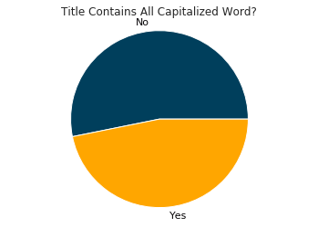
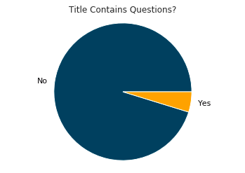
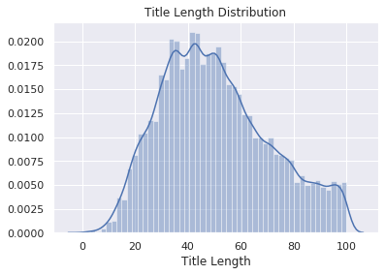
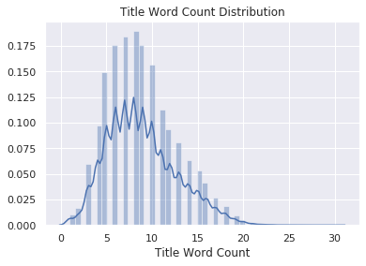
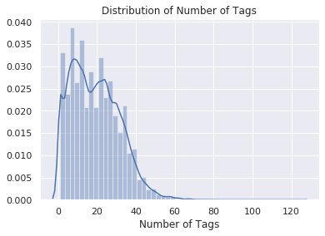
Titles and Tags
We create new features from titles and tags:
title_char_length
title_word_count
title_allcap
title_question
tag_nums

Slide 25
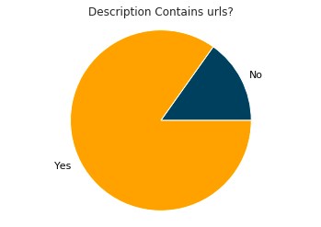
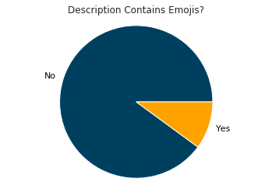
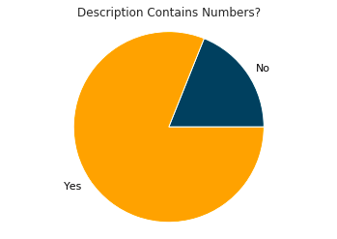
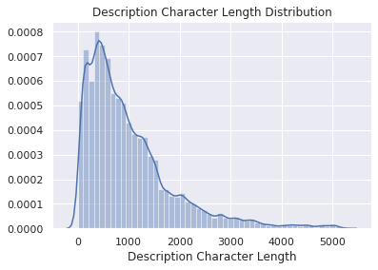
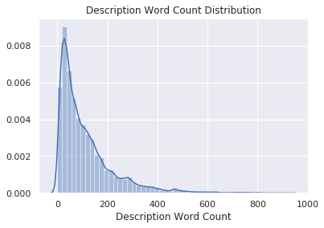
Descriptions
We create new features from descriptions::
desc_urls
desc_emojis
desc_nums
desc_char_length
desc_word_count

Slide 26
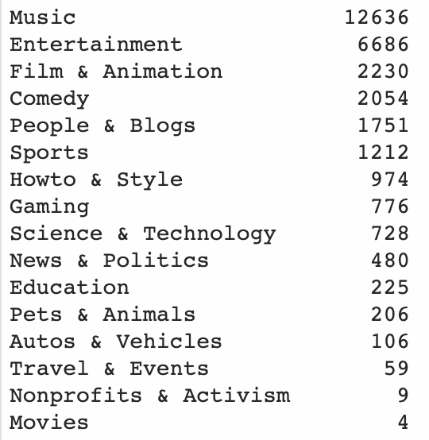
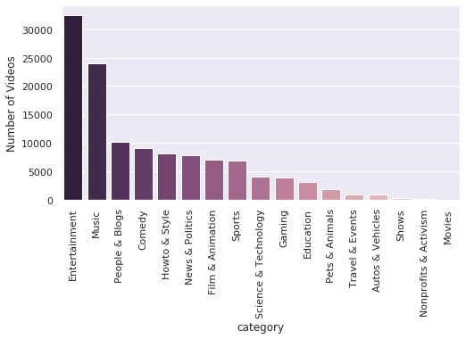
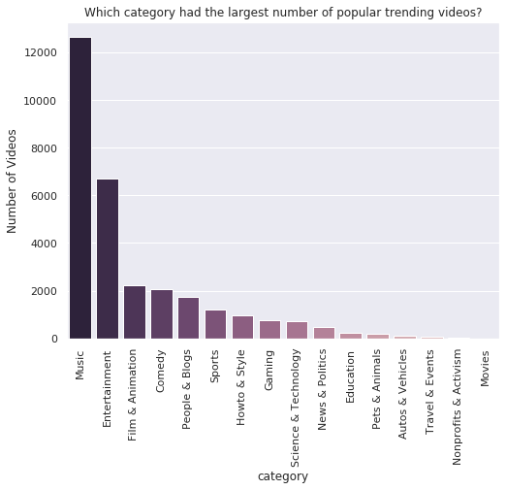
Popular Videos and Categories
Notes:
There are 17 different categories.
We see that the Entertainment category contains the largest number of trending videos among other categories: around 30,000 videos, followed by Music category with around 6,200 videos, followed by Howto & Style category with around 4,100 videos, and so on.

Slide 27

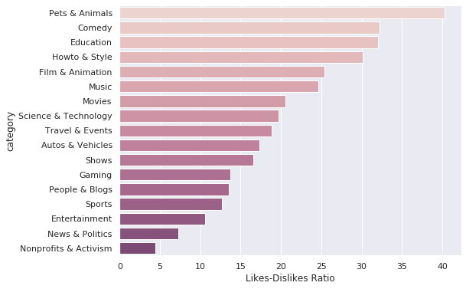
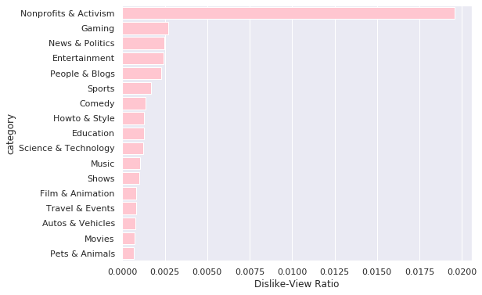
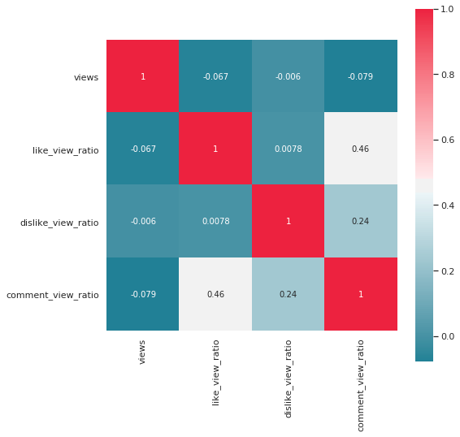

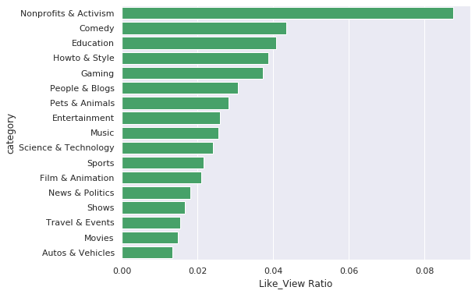
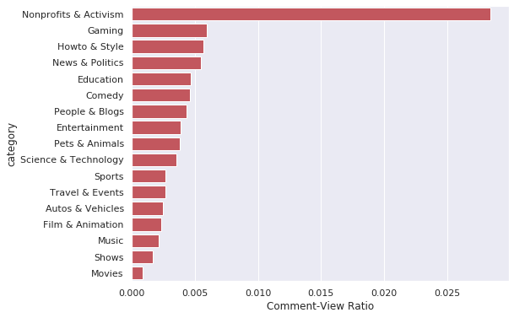
Views, likes, dislikes and comments ratio

Slide 28
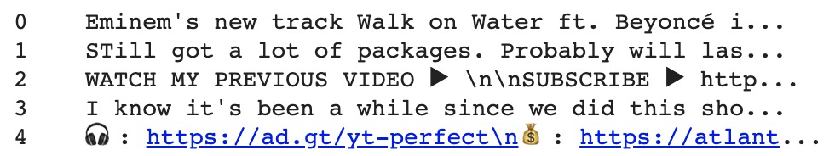
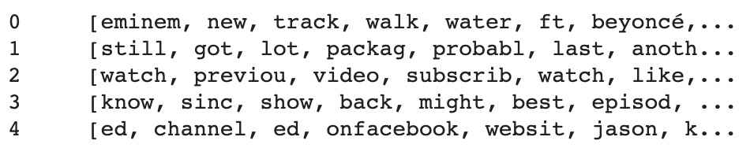
Text Data Cleaning
Covert Description
Convert to lowercase;
Remove numbers, punctuations, emojis, urls, leading/ending spaces
Basic NLP
Tokenization
Stemming
Lemmatization

Slide 29
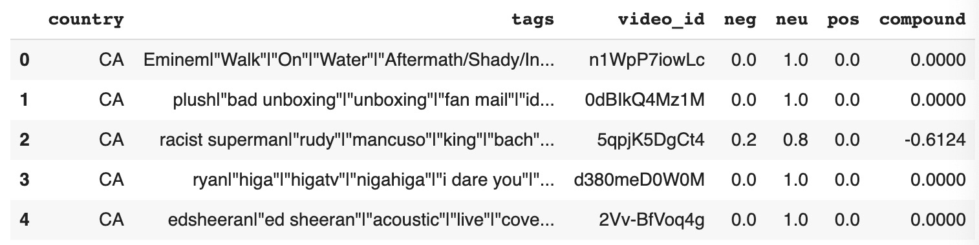
Sentiment Analysis for Tags
positive sentiment: c.s. >= 0.05
neutral sentiment: -0.05 < c.s. < 0.05
negative sentiment: c.s. <= -0.05
Compound Score - sum of all the lexicon ratings which have been normalized between -1 and +1

Slide 30
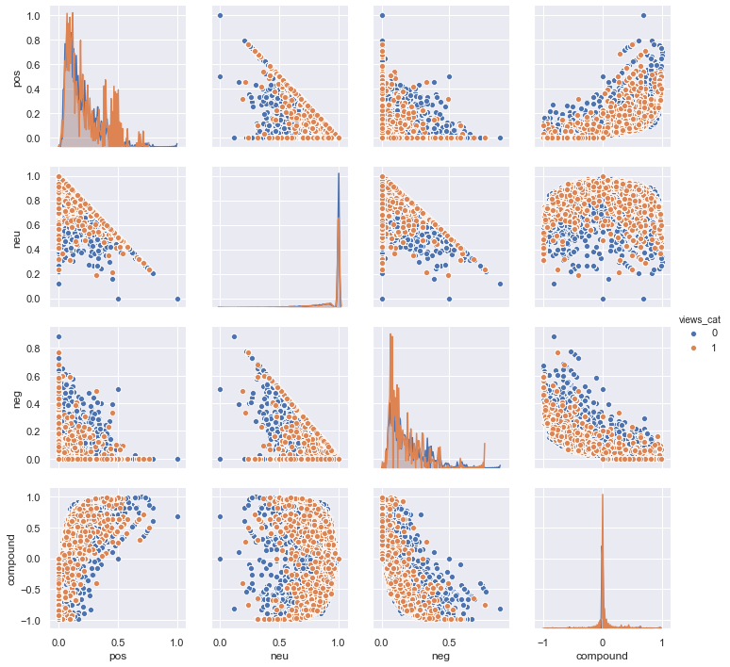
Pairplot of Scores by views_cat

Slide 31
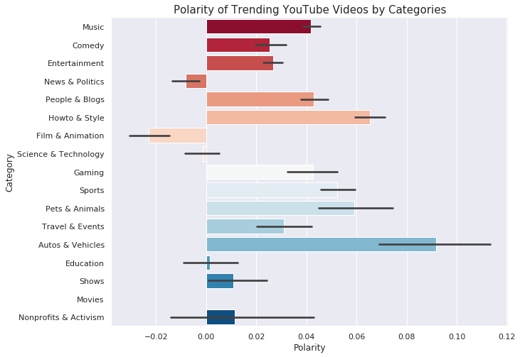
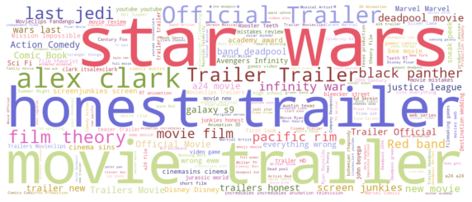

Polarity of Videos by Category
Film & Animation
Autos & Vehicles

Slide 32


Identify Video’s Brand Personality

Slide 33


Video’s Personality by views_cat

Slide 34

Correlation Matrix with Top 10 Features
Initial Dataset
shape: (120746, 17)
Current Dataset
(after Feature Engineering)
shape: (120746, 78)
Final Dataset
(after dropping object/repeated features)
shape: (120746, 51)

Slide 35

Modeling and Prediction

Slide 36



Pipeline
Original Dataset
Standardization
Dimension Reduction: PCA
Resampling: Perform oversampling using Adaptive Synthetic Sampling (ADASYN)
Dataset after Oversampling
Modeling
Naive Bayes
Logistic Regression
Linear Support Vector Classifier
Stochastic Gradient Descent Classifier
K Nearest Neighbor
Decision Tree Classifier
Random Forest Classifier
Gradient Boosting Classifier
Hyperparameter Tuning: Random Search
Notes:
Prevent data leakage
Train test split
Standardization
PCA: we chose 95% explained variance ratio as the threshold and kept 38 principal components for modeling
oversampling: to balance the classes, we performed ADASYN oversampling technique
ADASYN: It’s an improved version of Smote. What it does is same as SMOTE just with a minor improvement. After creating those sample it adds a random small values to the points thus making it more realistic. In other words instead of all the sample being linearly correlated to the parent they have a little more variance in them i.e they are bit scattered.
Modeling: tried 8 different models to compare their performance
Why not using SVM: The fit time complexity is more than quadratic with the number of samples which makes it hard to scale to dataset with more than a couple of 10000 samples.
Tune the hyperparameter to improve models’ performance

Slide 37

Precision
Baseline Model
Notes:
Because the goal of this project is to prevent which video is most likely to go viral. it is crucial to check the precision score of the popular video class.
we first ran the baseline models without pca and without tuning the hyperparameters
Without tuning the hyperparameter, we can see that random forest currently has the highest precision score of the popular video class. Meanwhile,, the precision score of the popular video class generated by the non-linear classifiers also outperformed linear ones.

Slide 38

Training Time
Baseline Model

Slide 39

Precision
Hyperparameter Tuning
Choose Gradient Boosting Classifier as the final model
Compare training score and cross validation score to check overfitting/underfitting

Slide 40








Classification Report
Hyperparameter Tuning
Notes:
Choose GBM as the final model

Slide 41



Feature Importance
Most important features
Description length
Number of tags
Title length
Publish hour
Music

Slide 42



Unstructured Data Modeling
Tfidf Vectorizer
Dimension: 46,433
TruncatedSVD
Dimension: 4,000 (85% Explained Variance)
Word Embedding
Notes:
The previous models are mostly based on structured data, but we are curious to see what result we could get from unstructured data.
Therefore, we took the video descriptions, use the word embeddings technique to create neural networks and predict which video will go viral. Meanwhile, we also tried to leverage transfer learning by using the pre-trained gloVe word vectors to do the classification work. As we can see, only using the video description feature, we still achieved a pretty high accuracy.
Here, we applied tsne to showcase the word vector space with a 2-dimensional representation.
Steps:
-embedding layer
definition the vocab_size
one-hot-encoding
pad documents to max length
train test split
build the model
embedding layer
classification
initialize the tokenizer object, and fit the tokenizer on the whole text
each word is assigned a unique number
converts each sentence into a sequence of numbers
padding with the same length

Slide 43


Word Vector Space
Shop
Commercial

Slide 44

Future Work and Deployment

Slide 45

Project Potential
Current Project
Classification model for marketing companies to spot videos most likely to go viral
Potential Improvement
A recommendation system that matches video suggestion with company’s brand personality
Future Development
Analyze company’s target clientele and recommend videos with matching target audience
Notes:
We only solve the problem of predicting whether a video will become popular. Whether video suits brand image and how much a company wants to spend on one video is still under their discretion. A potential improvement for the near future is to build a recommendation system that can match video suggestion with brand persoanlity.
If we can get information on video viewers, then we can consider further developing the project and analyze the company’s target clientele and recommend videos with matching target audience

Slide 46

Thank you!

Slide 47



Appendix: Three Boolean Features
False 120627
True 119
Name: video_error_or_removed,
dtype: int64
False 118847
True 1899
Name: comments_disabled,
dtype: int64
False 120026
True 720
Name: ratings_disabled,
dtype: int64
Notes:
To see how many trending videos got removed or had some error
We can see that out of videos that appeared on trending list there is a tiny portion (119 videos) with errors.
How many trending videos have their comments disabled?¶
We see that only 2% of trending videos prevented users from commenting.

Slide 48

Appendix: Final Model
Gradient Boosting Classifier
'learning_rate': 0.001
'max_depth': 59
'max_features': 7
'min_samples_leaf': 4
'min_samples_split': 8
'n_estimators': 186
'subsample': 1.0

Slide 49
Appendix:
Steps for Building the Embedding Layer
Embedding Layer
Definition the vocabulary size
One-hot-encoding the corpus
Pad documents to max length
Train test split
Build the model
Embedding layer
Classification layer
Compile
Fit and Evaluate
GloVe
Initialize the tokenizer object, and fit the tokenizer on the whole corpus
Converts each sentence into a sequence of numbers
Padding with the same length
Extract features from the pre-trained word vectors
Build the model
Embedding layer
Classification layer
Compile
Fit and Evaluate

Slide 50


Appendix: Topic Modeling
Politics
Beauty & Cosmetics
Notes:
word embeddings
nlp - human generated data
image - generated by machine
BERT are what embeddings now being transferred into, take words as it is, fine-tune it, and make predictions

